Slide 1
Flowcharts and Algorithms
Visually Representing Process Logic

Slide 2
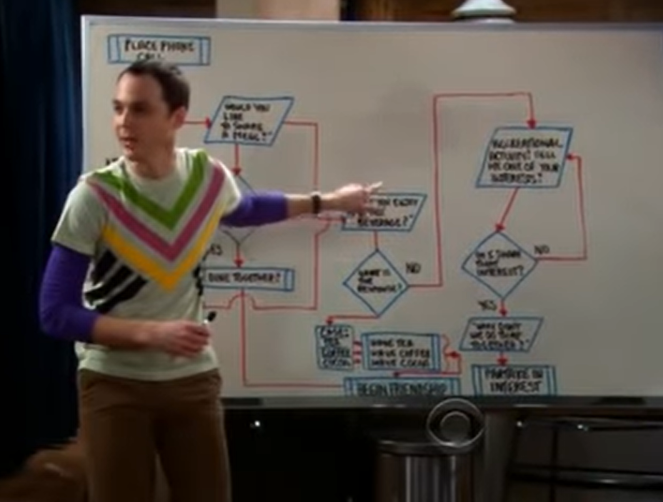
https://www.youtube.com/watch?v=k0xgjUhEG3U

Slide 3
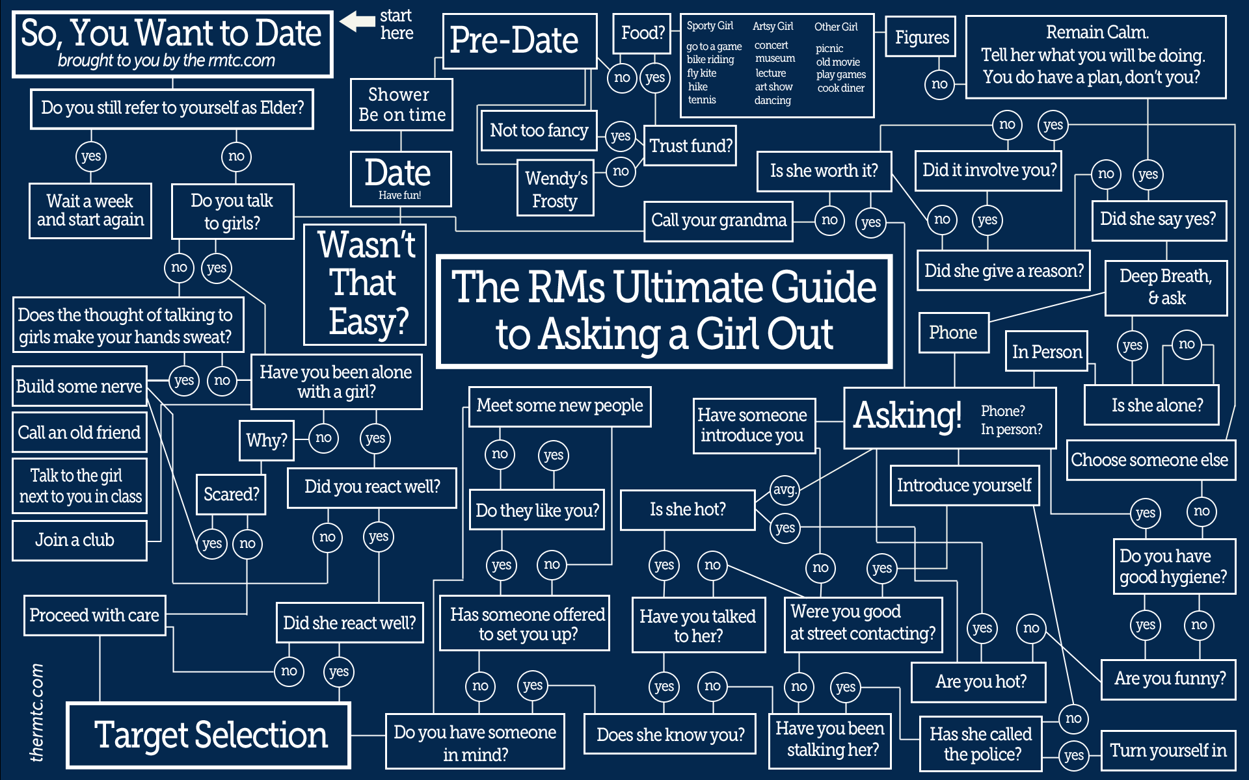

Slide 4
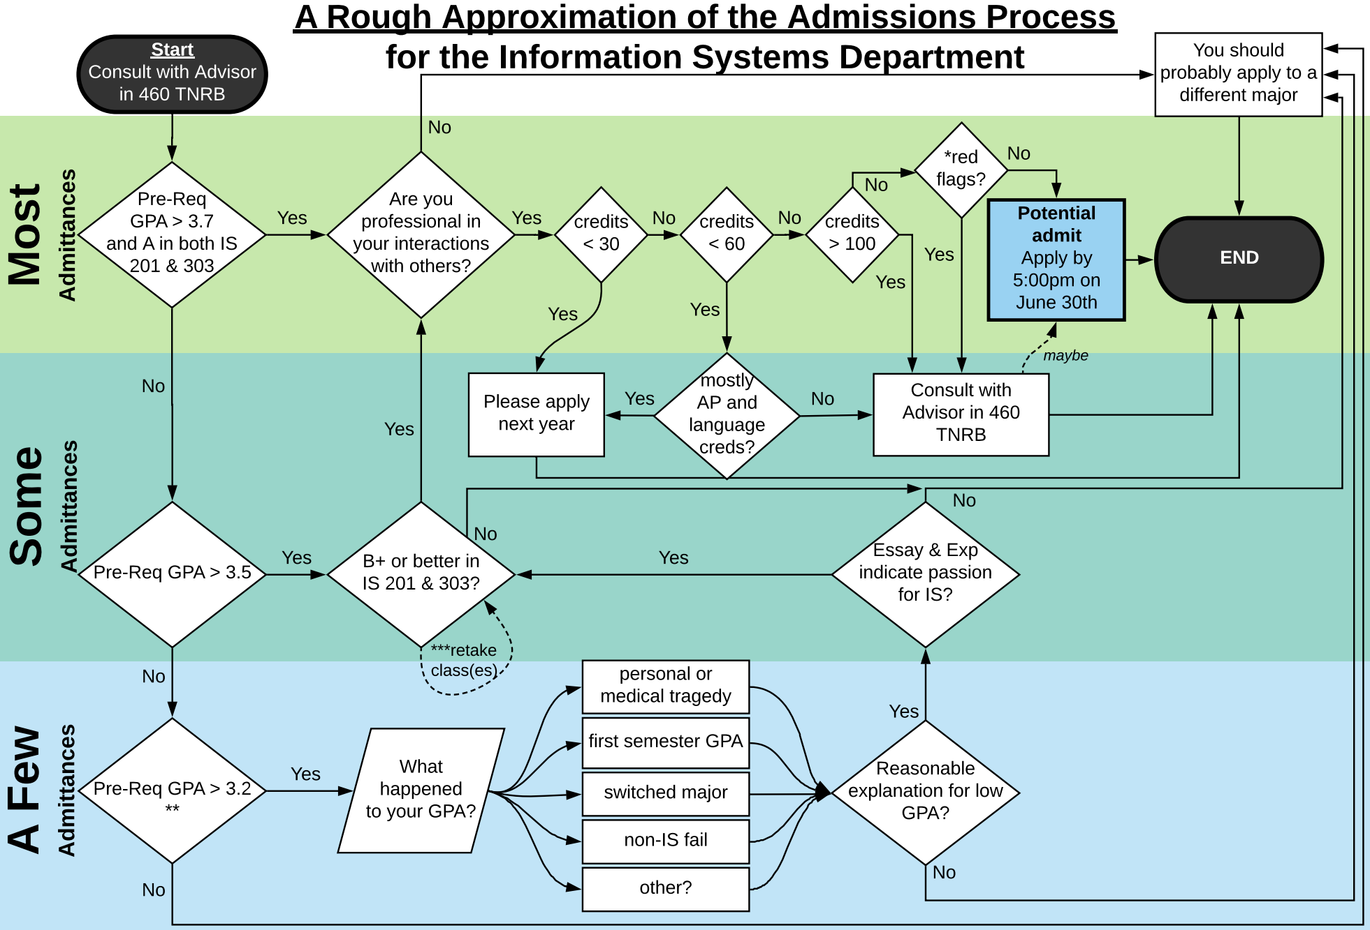
*The Information Systems Department reserves the right to allow exceptions in the admission process where it is deemed necessary to admit the most qualified students.
**Students with a Pre-Req (IS201, IS303, FIN201, MKTG201, ACC200) GPA of less than 3.0 cannot be admitted into any Marriott School program. This is a Marriott School policy.
***Retaken classes are discounted by 1/3 GPA (i.e., if you receive an A the second time around, we treat that like an A-).
FOR MORE INFO, PLEASE SEE AN ADVISOR IN 460 TNRB.

Slide 5
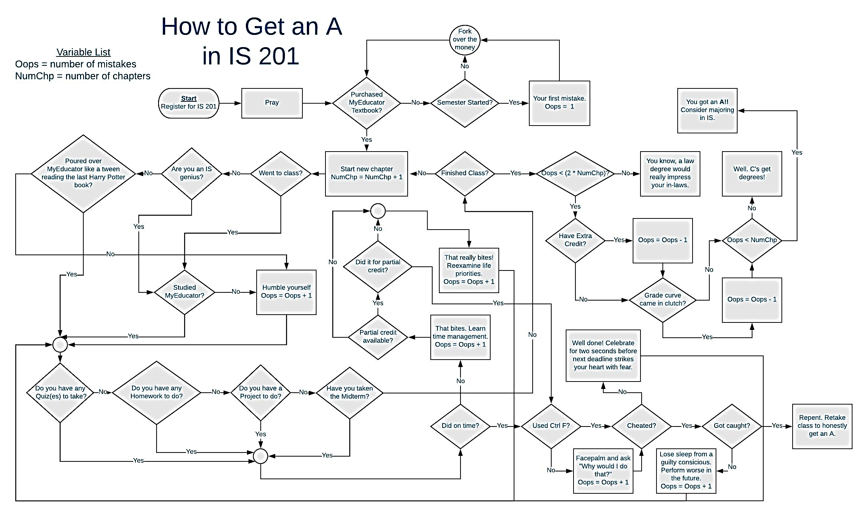

Slide 6
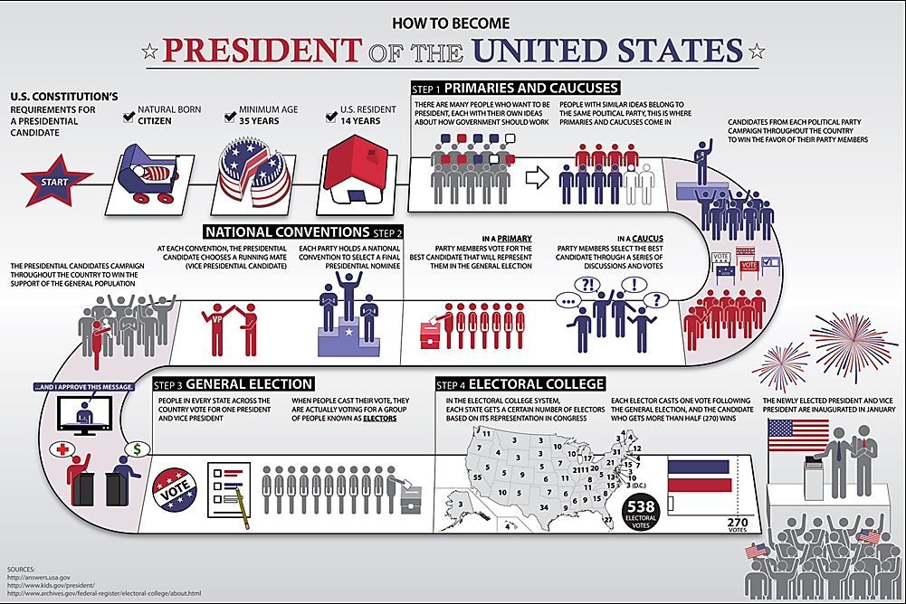

Slide 7
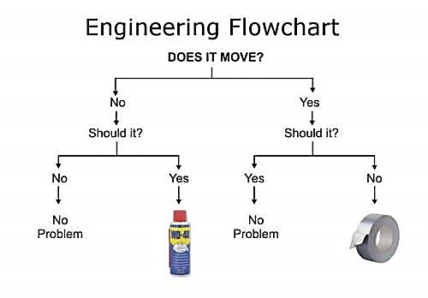

Slide 8
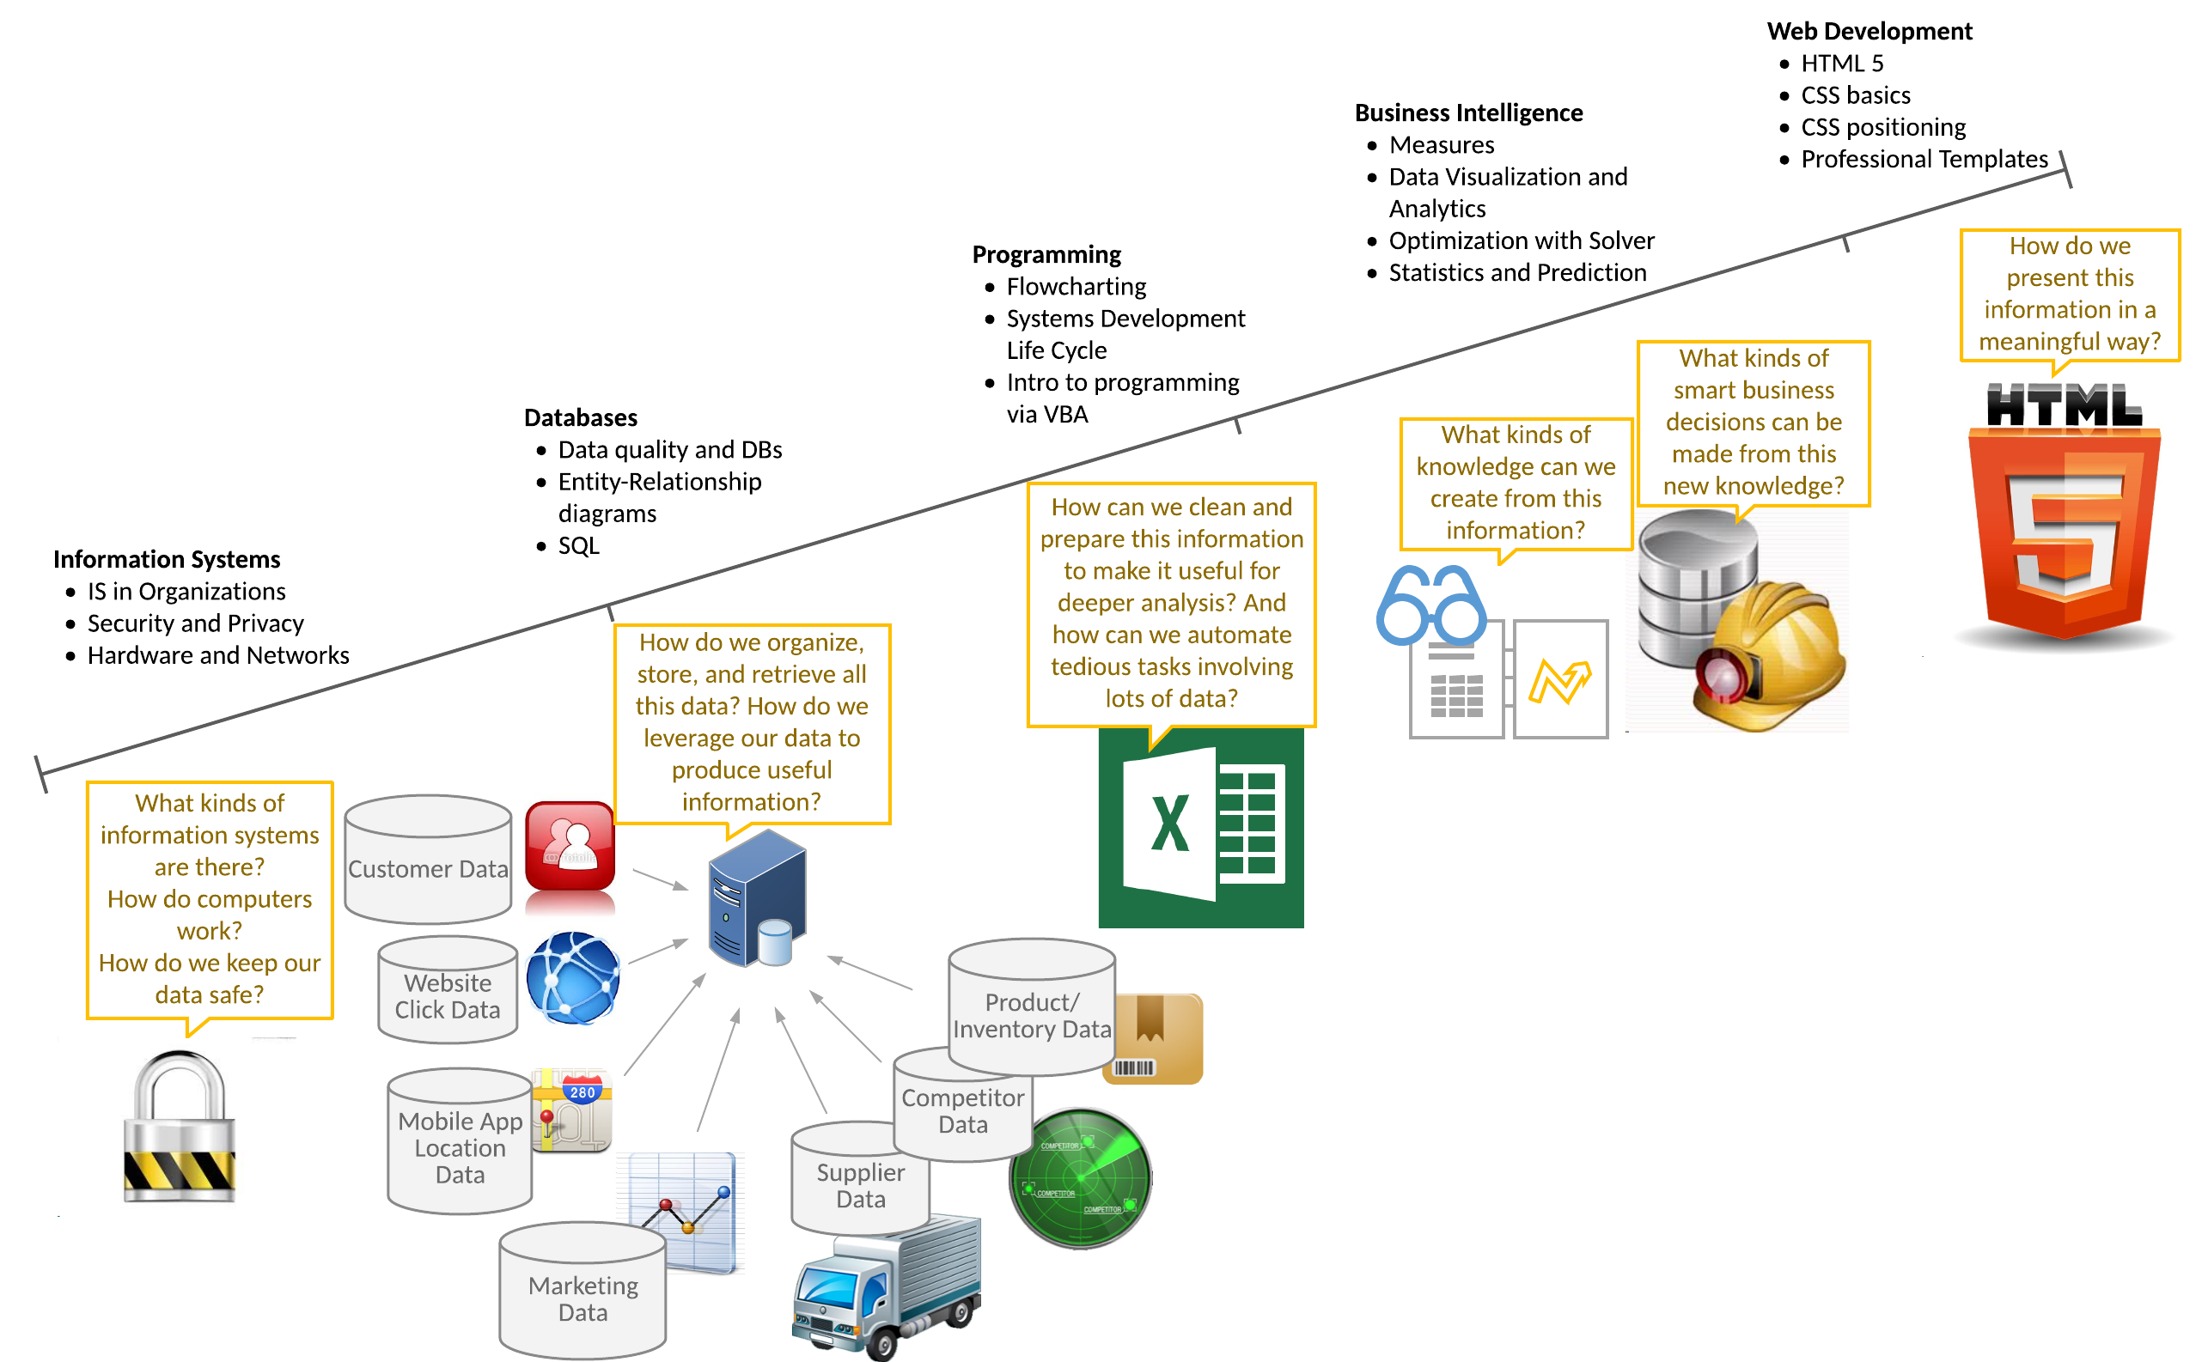
Where are we?

Slide 9
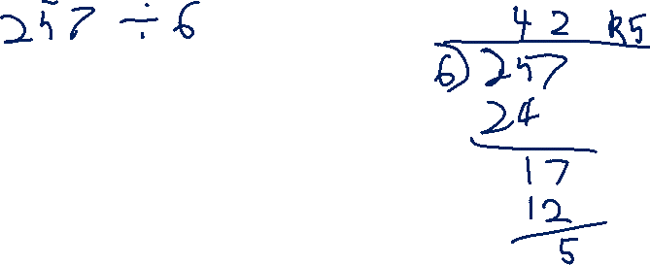
Algorithm
A Process or set of rules to be followed in problem-solving operations
Flow Chart
A representation of an algorithm in graphical form

Slide 10
Why Do Flowcharting?
Economical expression of process logic “A picture is worth a thousand words.”
Independent of implementation
Physical or logical processes
Supports any programming environment
Works well for technical and non-technical people.

Slide 11
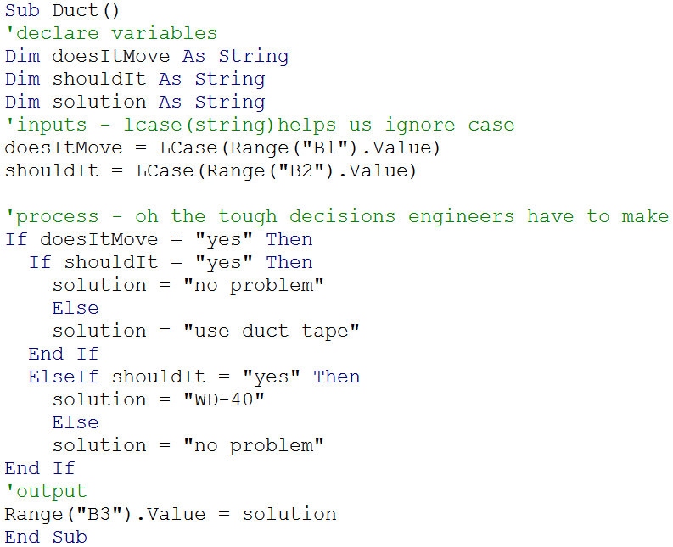
Which of these will be understood by most people?

Slide 12
Where does Flowcharting Fit in the SDLC?
Planning: to brainstorm preliminary process logic
Analysis: to document current process logic
Design: to communicate logic to developers
Development: to translate logic into code
Testing: to provide testers with scripts
Implementation: to communicate with users
Maintenance: to call upon as documentation

Slide 13
Let’s flowchart: Problem 1
John Brown wants to find out how much money (the balance) he will have in his savings account after a certain number of years.
He knows:
The amount he will deposit
The interest rate he will receive
The number of years he will save his money
Assumption: interest is compounding.

Slide 14
Think Like A Computer
First:
Input the data (it can do nothing without data)
Second:
Perform the algorithm (i.e., process inputs)
(Make decisions and calculations)
Third:
Output the results to users

Slide 15
Flowchart Symbols
Start/End
The Start and End symbol begins and ends the process
The Input/Output (a.k.a. “data”) symbol is used to represent inputs from the user or outputs to the user
The Decision symbol is a junction where a decision must be made. A decision must return true or false
The Process symbol is used to represent any type of function or action. This symbol may be used to represent one step or a sequence of steps. This is where we make calculations
The Connector symbol is used when more than one flow arrow head needs to come together.
The Flow symbol represents movement to the next operation
I/O
Decide
Do
Something

Slide 16
Understand the Algorithm
Compound Interest algorithm:
Balance = Deposit * (1 + Rate)^{years}
Required
Develop a flowchart to calculate and display the balance in a savings account.

Slide 17
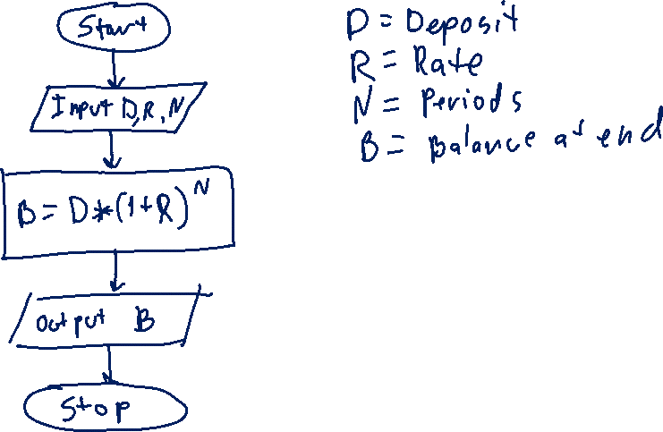
Compound Interest Flowchart

Slide 18
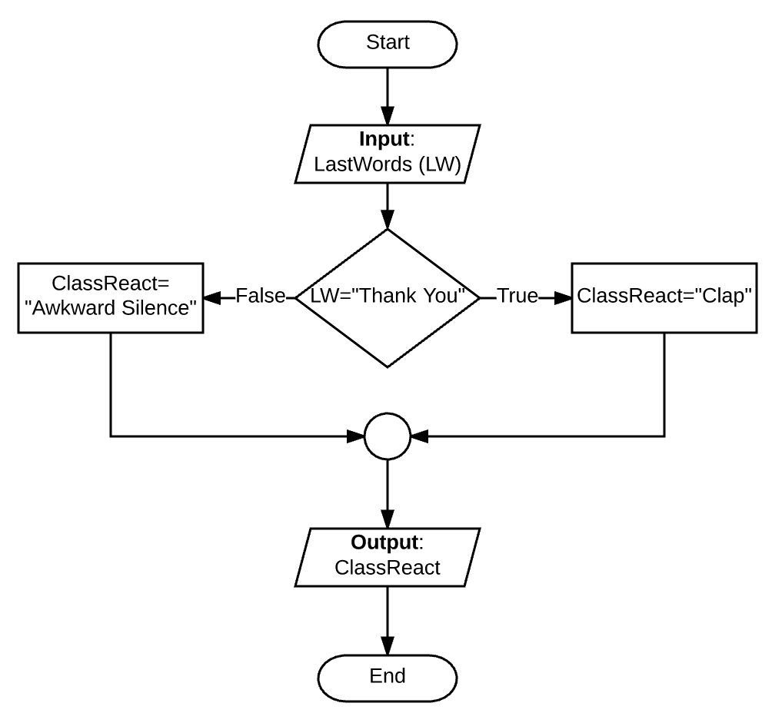
Sub clapLogic()
If announcerEndsWith = "Thank You" Then
classReaction = "Clap"
Else
classReaction = "Awkward Silence"
End If
End Sub

Slide 19
Beefnut!
Captain Beefnut, owns the Beefnut Doughnut Shop. He needs a program that will calculate and print bills for his customers.
His usual price for doughnuts is 60 cents each, but in order to increase sales he has reduced the price to 40 cents each if a customer buys 12 or more.
Inputs (variables)
Number of Donuts (NOD)
Process
If NOD<12 then Bill = .6*NOD
Else Bill=.4*NOD
Output
Bill
Notes:
I like to use a google poll to allow the students to indicate when they are done. The poll consists of two answers: 1. Yes I’m done, 2. Move on without me.

Slide 20
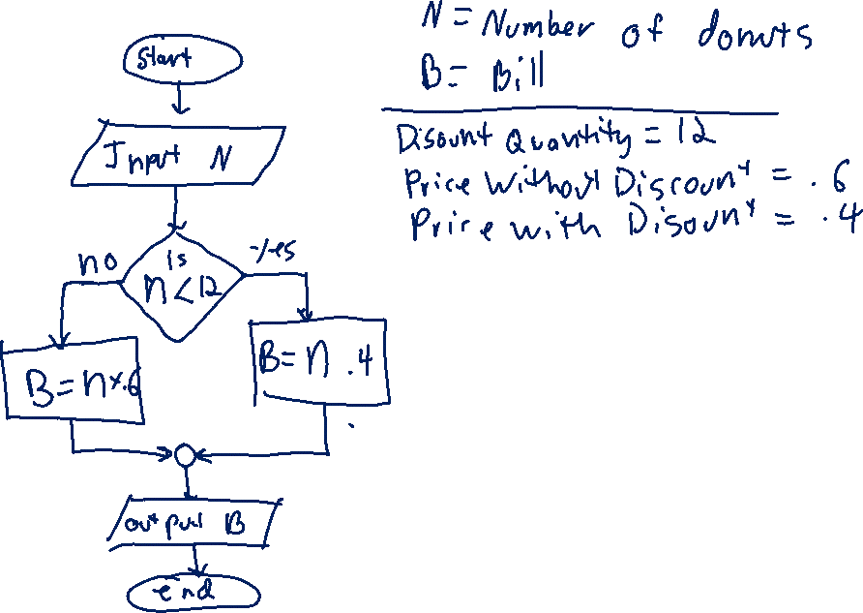
Beefnut Flowchart

Slide 21
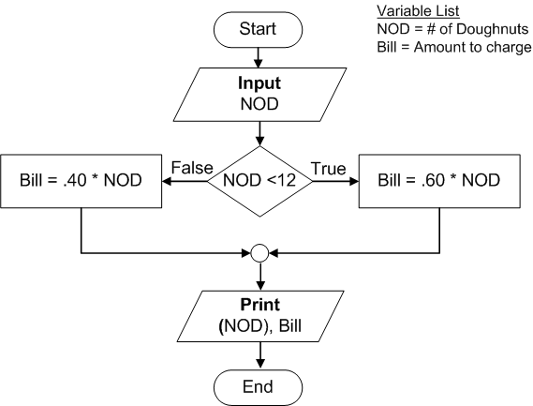
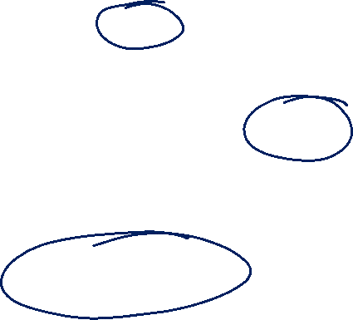
Variable List
NOD = # of donut
Bill = Amount to charge
PPD = Price per donut
Beefnut Solutions
Start
Variable List
NOD = # of donut
Bill = Amount to charge
Input
NOD, PPD=.6
NOD<12
False
PPD=.4
True
Bill=NOD*PPD
Print
(NOD), Bill
Which is better?
End

Slide 22
Consider an Extension
Suppose Captain Beefnut wanted his program to repeat the algorithm if there was another customer bill to calculate. Add a loop to accomplish this change.

Slide 23
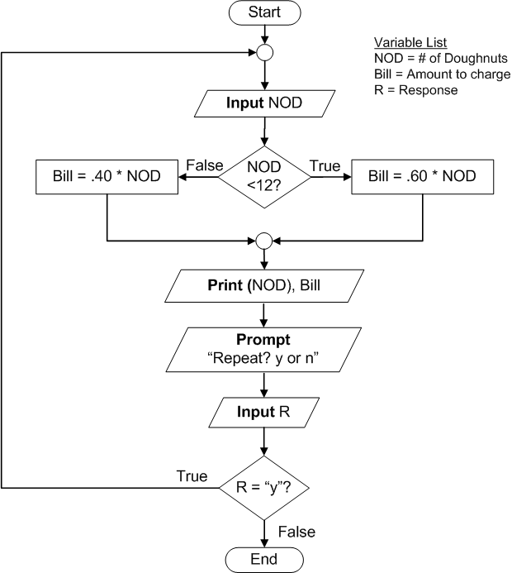
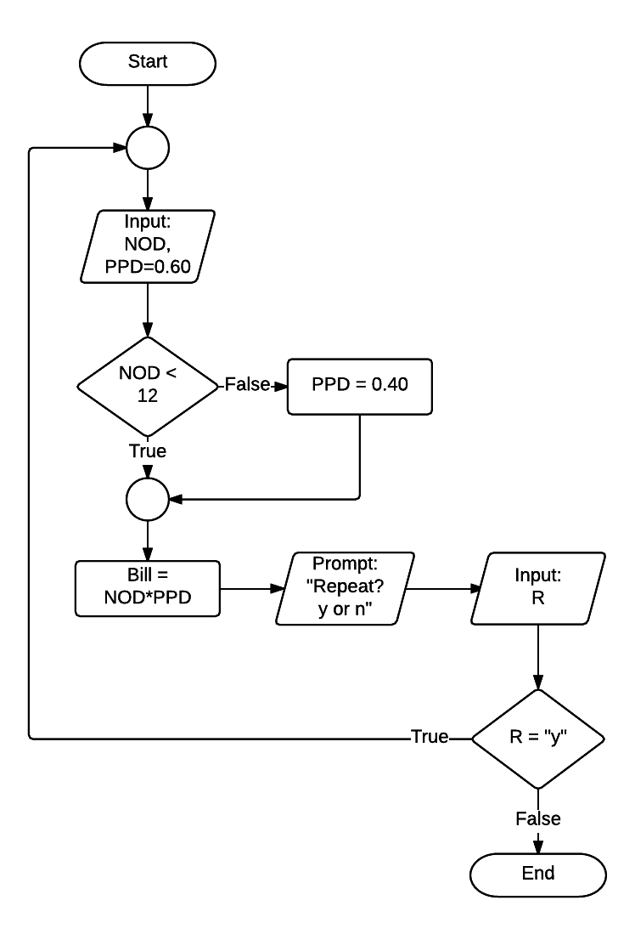
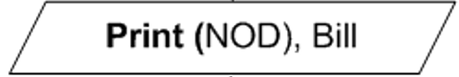
Variable List
NOD = # of donut
Bill = Amount to charge
R = Repeat
Variable List
NOD = # of donut
Bill = Amount to charge
PPD = Price per donut
R = Repeat

Slide 24
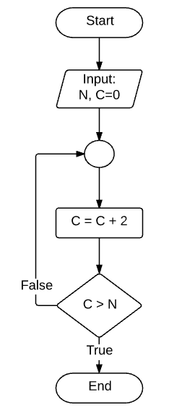

Loop termination table
Give me a number (N)
Count (C) by 2 (C=C+2)
If C is greater than N, END
ELSE iterate Count
Iteration | C | N | C>N?
0 | 0 | 10 | 0>10=False
1 | 2 | 10 | 2>10=False
2 | 4 | 10 | 4>10=False
3 | 6 | 10 | 6>10=False
4 | 8 | 10 | 8>10=False
5 | 10 | 10 | 10>10=False
6 | 12 | 10 | 12>10=True

Slide 25
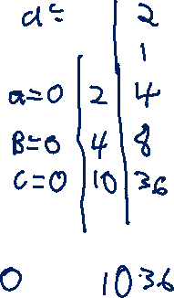
Sequence of operations
Start
Input
N
A=N
What is the value of C when:
N=0
N=1
N=2
B=1
A=A+B*A
B=A+B*A
C=A+B*A
Display
C
End
Notes:
0 – 0
1 – 10
2 – 36

Slide 26
You try this one first
At the Betelgeuse Bungalows hotel we provide discounts based on different membership levels.
Non-member = 0% discount
Dung Beetle = 5% discount
Silver Water Beetle = 15% discount
Golden Scarab Beetle = 25% discount
A customer provides the following information at check-in:
Membership level, number of nights stay, room preference (which has a room rate)
Develop this in flowchart form to calculate the charge for the customer’s stay.

Slide 27
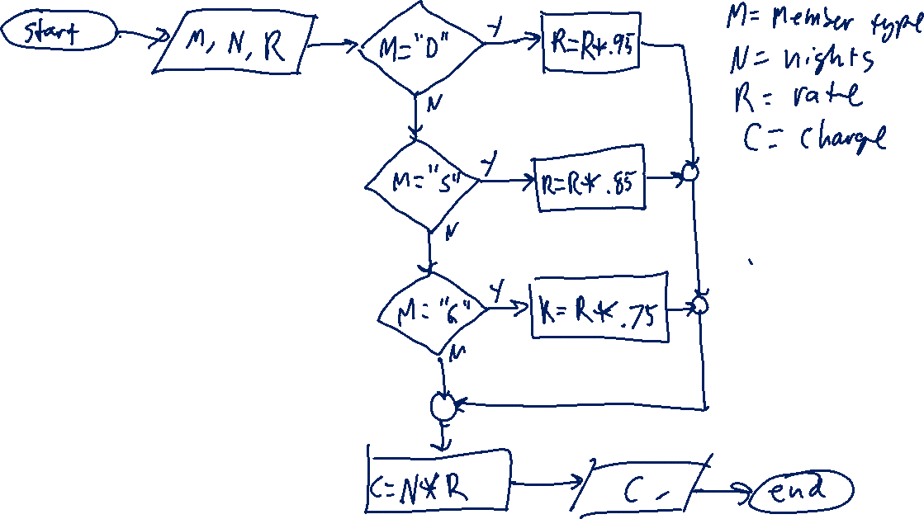

Slide 28
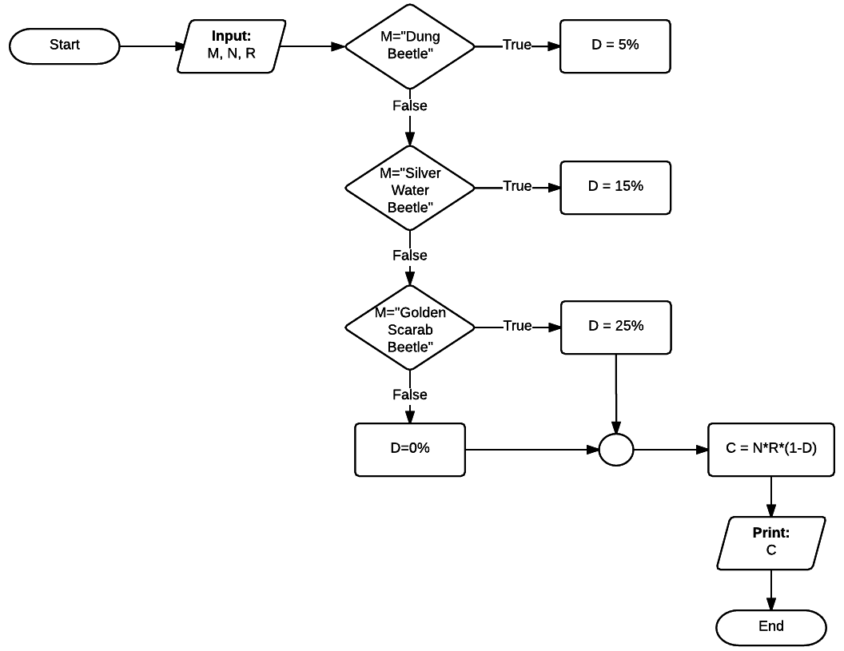
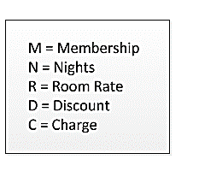
Solution

Slide 29
Practice Problem
RFT Company pays its salespeople weekly according to the following commission schedule:
Weekly Sales | Commission Rate
Sales < $1000 | 10%
$1000 <= Sales < $5000 | 20%
Sales >= $5000 | 30%
Design a flowchart to accept the sales person’s name (N) and weekly sales amount (S). It should calculate the weekly sales commission. It should print (N), (S) and the Commission (C) (not the commission rate).

Slide 30
Practice Flowchart

Slide 31
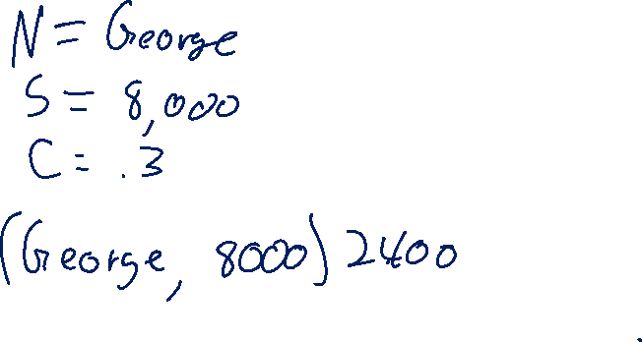
Practice
Solution
(If-Then-Else)
Notes:
Grading rules
If more than 2 diamonds, take off 2 points.
If no end circle for each diamond, take off 1 point

Slide 32
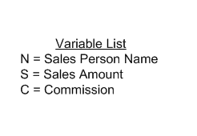
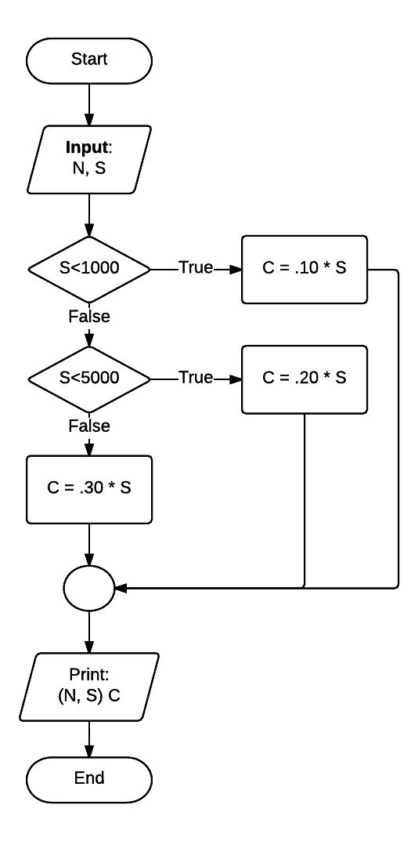
Practice Solution (Nested Ifs)
Notes:
Grading rules
Should be three diamonds. If not, take off 2 points.
If no end circle for each diamond, take off 1 point

Slide 33
FYI
Guidelines | Description
Completeness | A flowchart should be complete so that all necessary steps and decisions are included
Clarity | A flowchart should be clear and unambiguous
Flow direction | Flowcharts are drawn so that flow goes from top to bottom or left to right
Single process exit | Only one flow line should exit from a process symbol
Flows related to decisions | Only one flow line should enter a decision symbol, but two flow lines should exit, one for each possible outcome
Single start flow | Only one flow line should exit a start symbol
Single end flow | Only one flow line should enter an end symbol. It is possible to have multiple end symbols because multiple situations can lead the program to terminate
Connector symbols | Connector symbols should be used when multiple arrow heads need to come together. Only one arrow should leave a connector symbol

Slide 34
Intro to VBA* Programming (If we have time)
* Visual Basic for Applications: A programming language built into Microsoft Office applications including Excel, Word, PowerPoint and more.
Perform calculations beyond the scope of Excel functions
Automate repetitive operations
Validate data – check for errors
Integrate with other components such as external data sources
More…

